Slide 1

Evaluation of Multi-Layer Perceptron Algorithm : Digit Dataset
PRESENTED BY:
MUZAQI NUR ARIFIN
DIGITAL SKILL FAIR 36.0 - DATA SCIENCE
Dibimbing.id
Page 1

Slide 2
February 27th, 2025
Abstract
This project aims to evaluate the accuracy prediction of the Multilayer Perceptron (MLP) algorithm when applied to the digits dataset. The digits dataset, which consists of handwritten digit images, presents a challenging classification problem that is vital in various applications such as handwritten recognition and automated data entry systems.
The process begins with an introduction to the problem, detailing the background and objectives of the study. The dataset is then described, highlighting the structure, and the preprocessing steps undertaken to prepare the data for model training. The data is divided into training and testing sets, ensuring a robust evaluation framework.
Dibimbing.id
Page 2

Slide 3
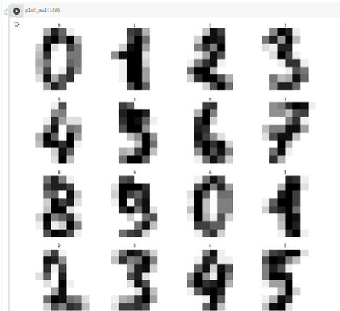
February 27th, 2025
Dataset
Explanation
DIGITS DATASET
Digis dataset is a data set containing a collection of handwritten numbers from 0 to 9 represented in image pixels. This data is quite complex because of its large number of rows and columns. Because of its complexity, it is usually used to bencmarking the algorithms of machine learning models.
COMPOSITION
Collection of 1,797 grayscale images of handwritten digits (0-9)
Each represented by an 8x8 pixel grid (64 features)
The pixel values range from 0 to 16
Dibimbing.id
Page 3

Slide 4
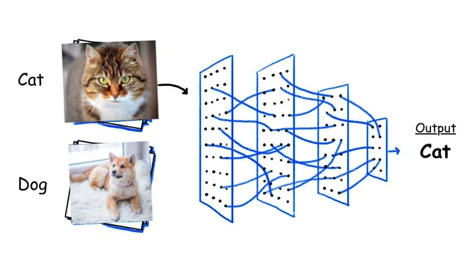
February 27th, 2025
THEORY OF MLP
A Multilayer Perceptron (MLP) is a type of neural network with an input layer, one or more hidden layers, and an output layer. Neurons in these layers use activation functions to model complex patterns, adjusting their connections' weights through forward and backpropagation to minimize errors. MLPs are versatile for tasks like classification and regression.
Algorithm Explanation
Why use this algorithm?
The Multilayer Perceptron (MLP) algorithm is ideal for digit datasets due to its ability to recognize complex patterns. MLP uses multiple layers of neurons to learn the different shapes and orientations of handwritten digits, making it highly effective for accurate digit classification.
Dibimbing.id
Page 4

Slide 5
February 27th, 2025
Hands On Session!
Dibimbing.id
Page 5

Slide 6
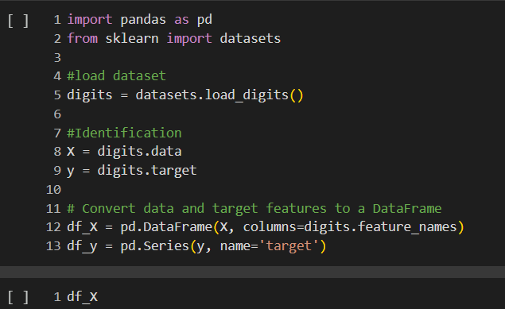
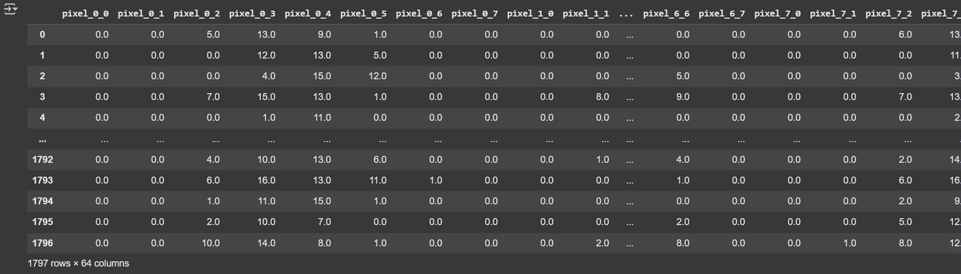
Preprocessing Data
February 27th, 2025
identify and view the content structure of the digits dataset
Dibimbing.id
Page 6

Slide 7
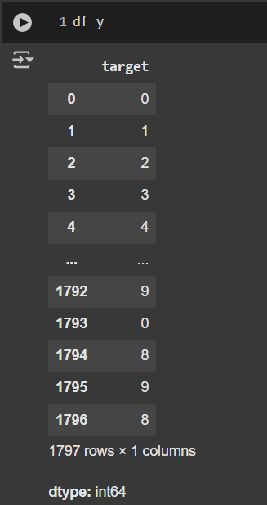

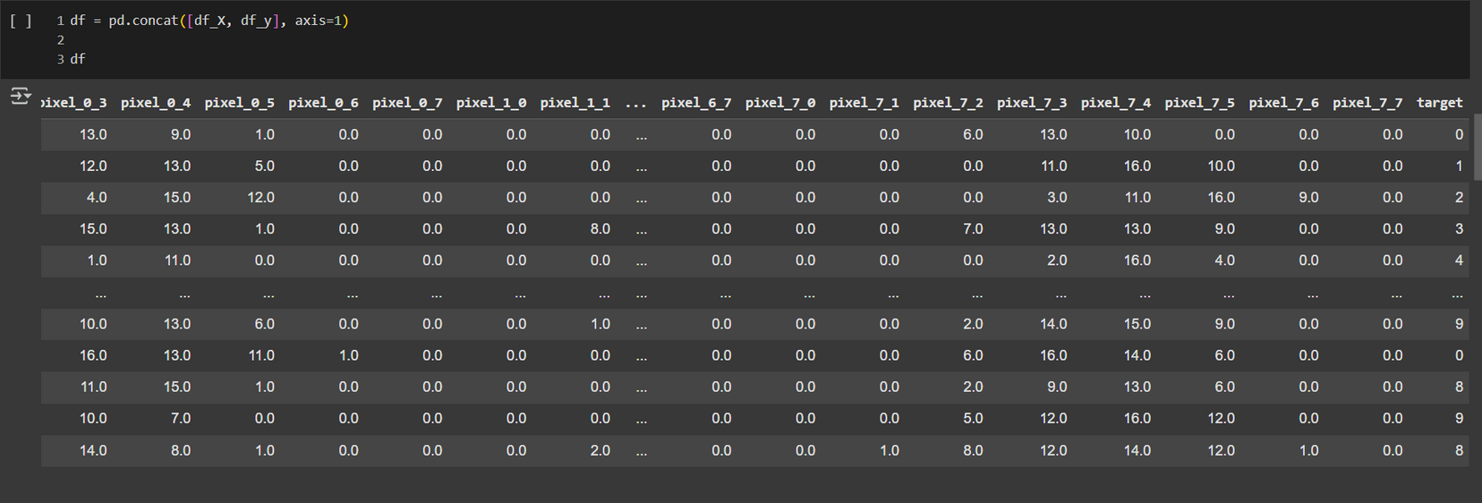
Preprocessing Data
February 27th, 2025
This code is used to merge the digits dataset table with the target table by df_y
Dibimbing.id
Page 7

Slide 8
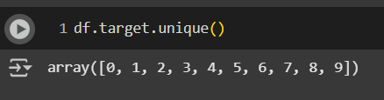
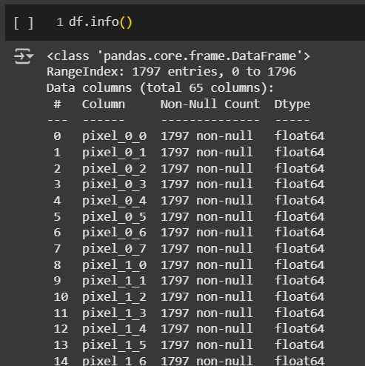
Preprocessing Data
February 27th, 2025
This code is used to find the target number, namely number 0-9.
Identifies whether there is any empty data in the digits dataset, and the result is that it is all filled.
Dibimbing.id
Page 8

Slide 9
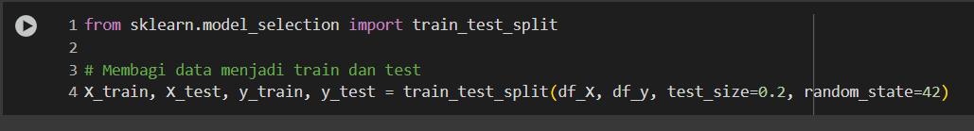
Splitting Data
February 27th, 2025
Import train_test_split from sklearn.model_selection.
Use train_test_split to split the dataset df_X (features) and df_y (targets/labels) into X_train, X_test, y_train, and y_test.
The parameter test_size=0.2 indicates that 20% of the data will be used for testing.
The parameter random_state=42 ensures reproducibility of the data split.
Dibimbing.id
Page 9

Slide 10
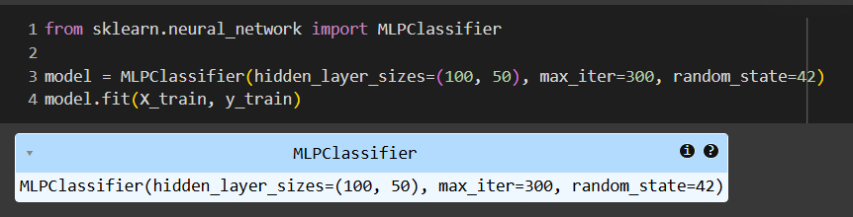
Multi-Layer Perceptron Algorithm Implelementation
February 27th, 2025
Import MLPClassifier: The code starts by importing the MLPClassifier.
Initialize Model: It initializes the model with two hidden layers (100 neurons in the first layer, 50 in the second), sets a maximum of 300 iterations for training, and ensures reproducibility with random_state=42.
Train Model: Finally, it trains the model using the fit method with the training data X_train and y_train.
Dibimbing.id
Page 10

Slide 11
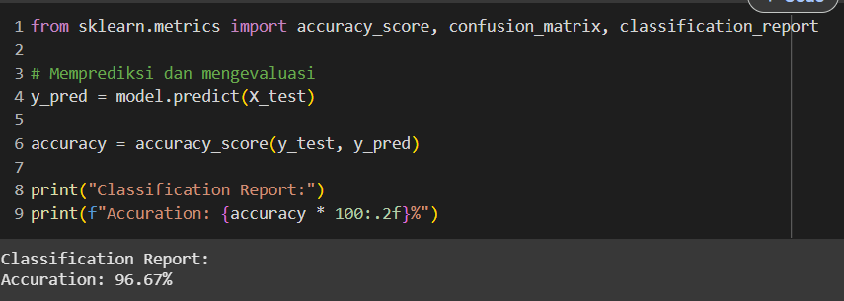
Multi-Layer Perceptron Algorithm Implelementation
February 27th, 2025
Import Metrics: Functions from sklearn.metrics for evaluation.
Predict: Use the trained model to predict X_test.
Calculate Accuracy: Determine accuracy with accuracy_score.
Print Report: Output the classification report and accuracy.
The evaluation of the model on the test data shows an accuracy of 96.67%, indicating that the algorithm works correctly
Dibimbing.id
Page 11

Slide 12
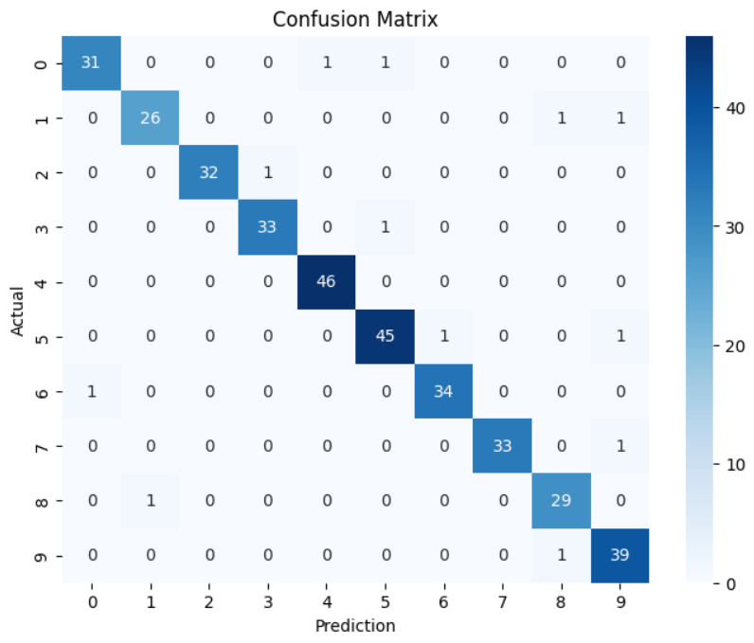
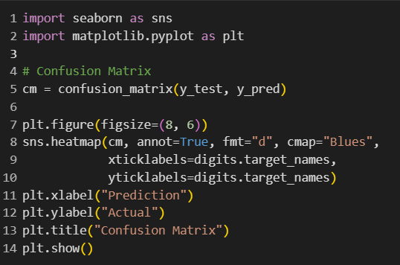
Data Visualization
February 27th, 2025
I use confusion matrix for data visualization to make it easy to read.
Dibimbing.id
Page 12

Slide 13
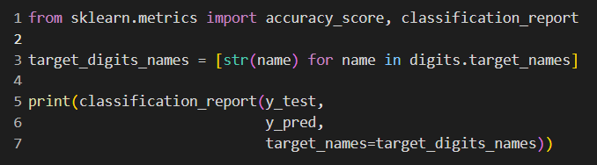
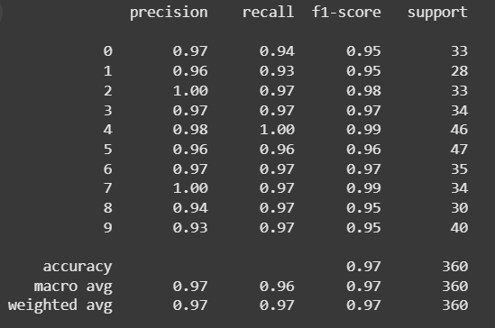
Data Visualization
February 27th, 2025
This shows a table containing evaluation metrics for a classification model. The table has four columns: precision, recall, f1-score, and support. Each row in the table represents a different class from 0 to 9. At the bottom of the table, there are overall metrics such as accuracy, macro avg, and weighted avg.
Dibimbing.id
Page 13

Slide 14
February 27th, 2025
Effectiveness of MLP Algorithm
The Multilayer Perceptron (MLP) algorithm has been proven effective for digit classification in datasets such as this digits dataset. Its ability to recognize complex patterns in the data allows it to accurately identify handwritten digits.
Model Performance
Conclusion
The evaluated MLP model showed an accuracy of 96.67%, indicating that the algorithm performs well in processing and classifying visual data.
Reliability for Classification Tasks
The evaluation results reinforce MLP as a reliable tool for digit classification tasks, which is very useful in various image recognition and computer vision applications.
Dibimbing.id
Page 14

Slide 15



February 27th, 2025
Thank You
Hy, it's me, Muzaqi !
Muzaqi Nur Arifin
@mnurar_4
Dibimbing.id
Page 15

